Slide 1
Self Balancing Robot
-by Abhishek Ghogare (153059006)

Slide 2
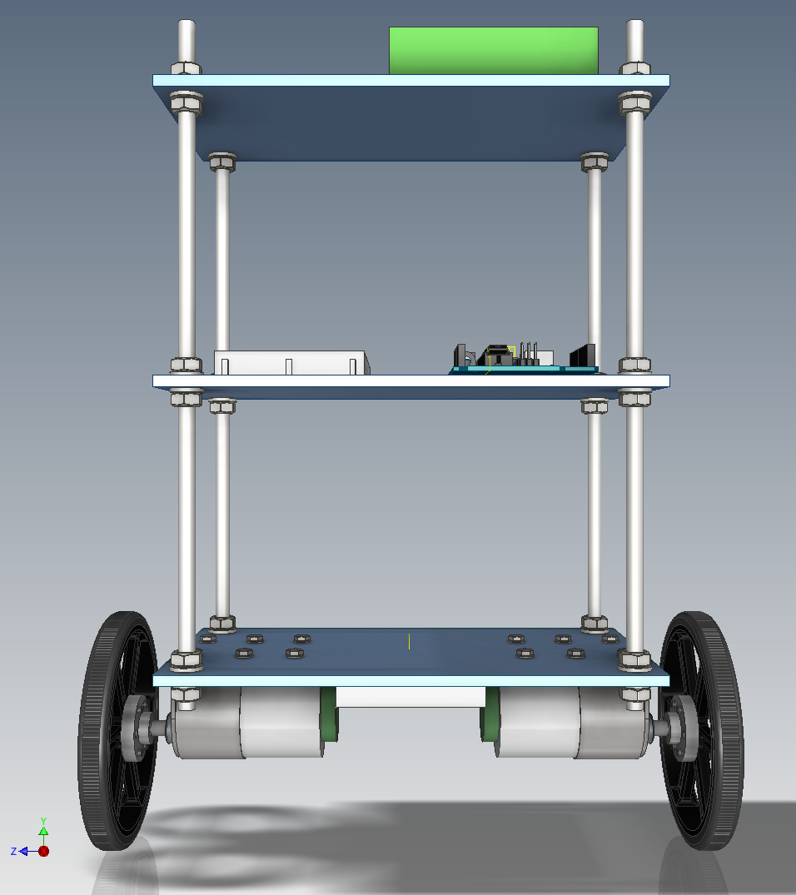
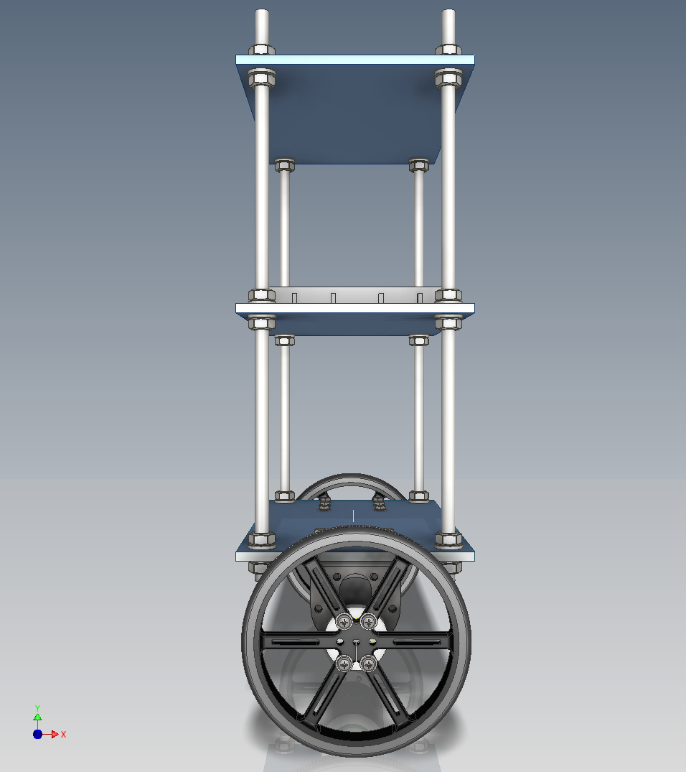
Problem Statement
Robot balances itself by moving in 1 dimension
Accelerometer/Gyro sensor detects the direction of fall
Microcontroller receives sensor data and acts on motors connected to wheels
Microcontroller should track the movement of the robot to maintain the its position

Slide 3
Task specifications
I2C protocol communication for MPU
Calculate bot angle with minimum noise
Calculate and smooth angle using only accelerometer
Use tan angle instead of sin to avoid max length calculation and error minimization
Integrate angular velocity over time to get angle
Two reasons to drift the angle
Non zero sensor output in steady state
Accumulation of error due to integration over time
Complementary filter, to fuse both angles
Use PID to balance bot
Quadrature encoder for position tracking
Quadrature encoder for speed tracking

Slide 4
MPU-9250 Communication
Two communication protocols to interact with MPU
SPI
Simple protocol
Pins : SCLK, MOSI, MISO, SS
I2C
Supports multi master-slave on same bus
Pins : SCL, SDA
Used I2C module and library from Tiva Launchpad

Slide 5
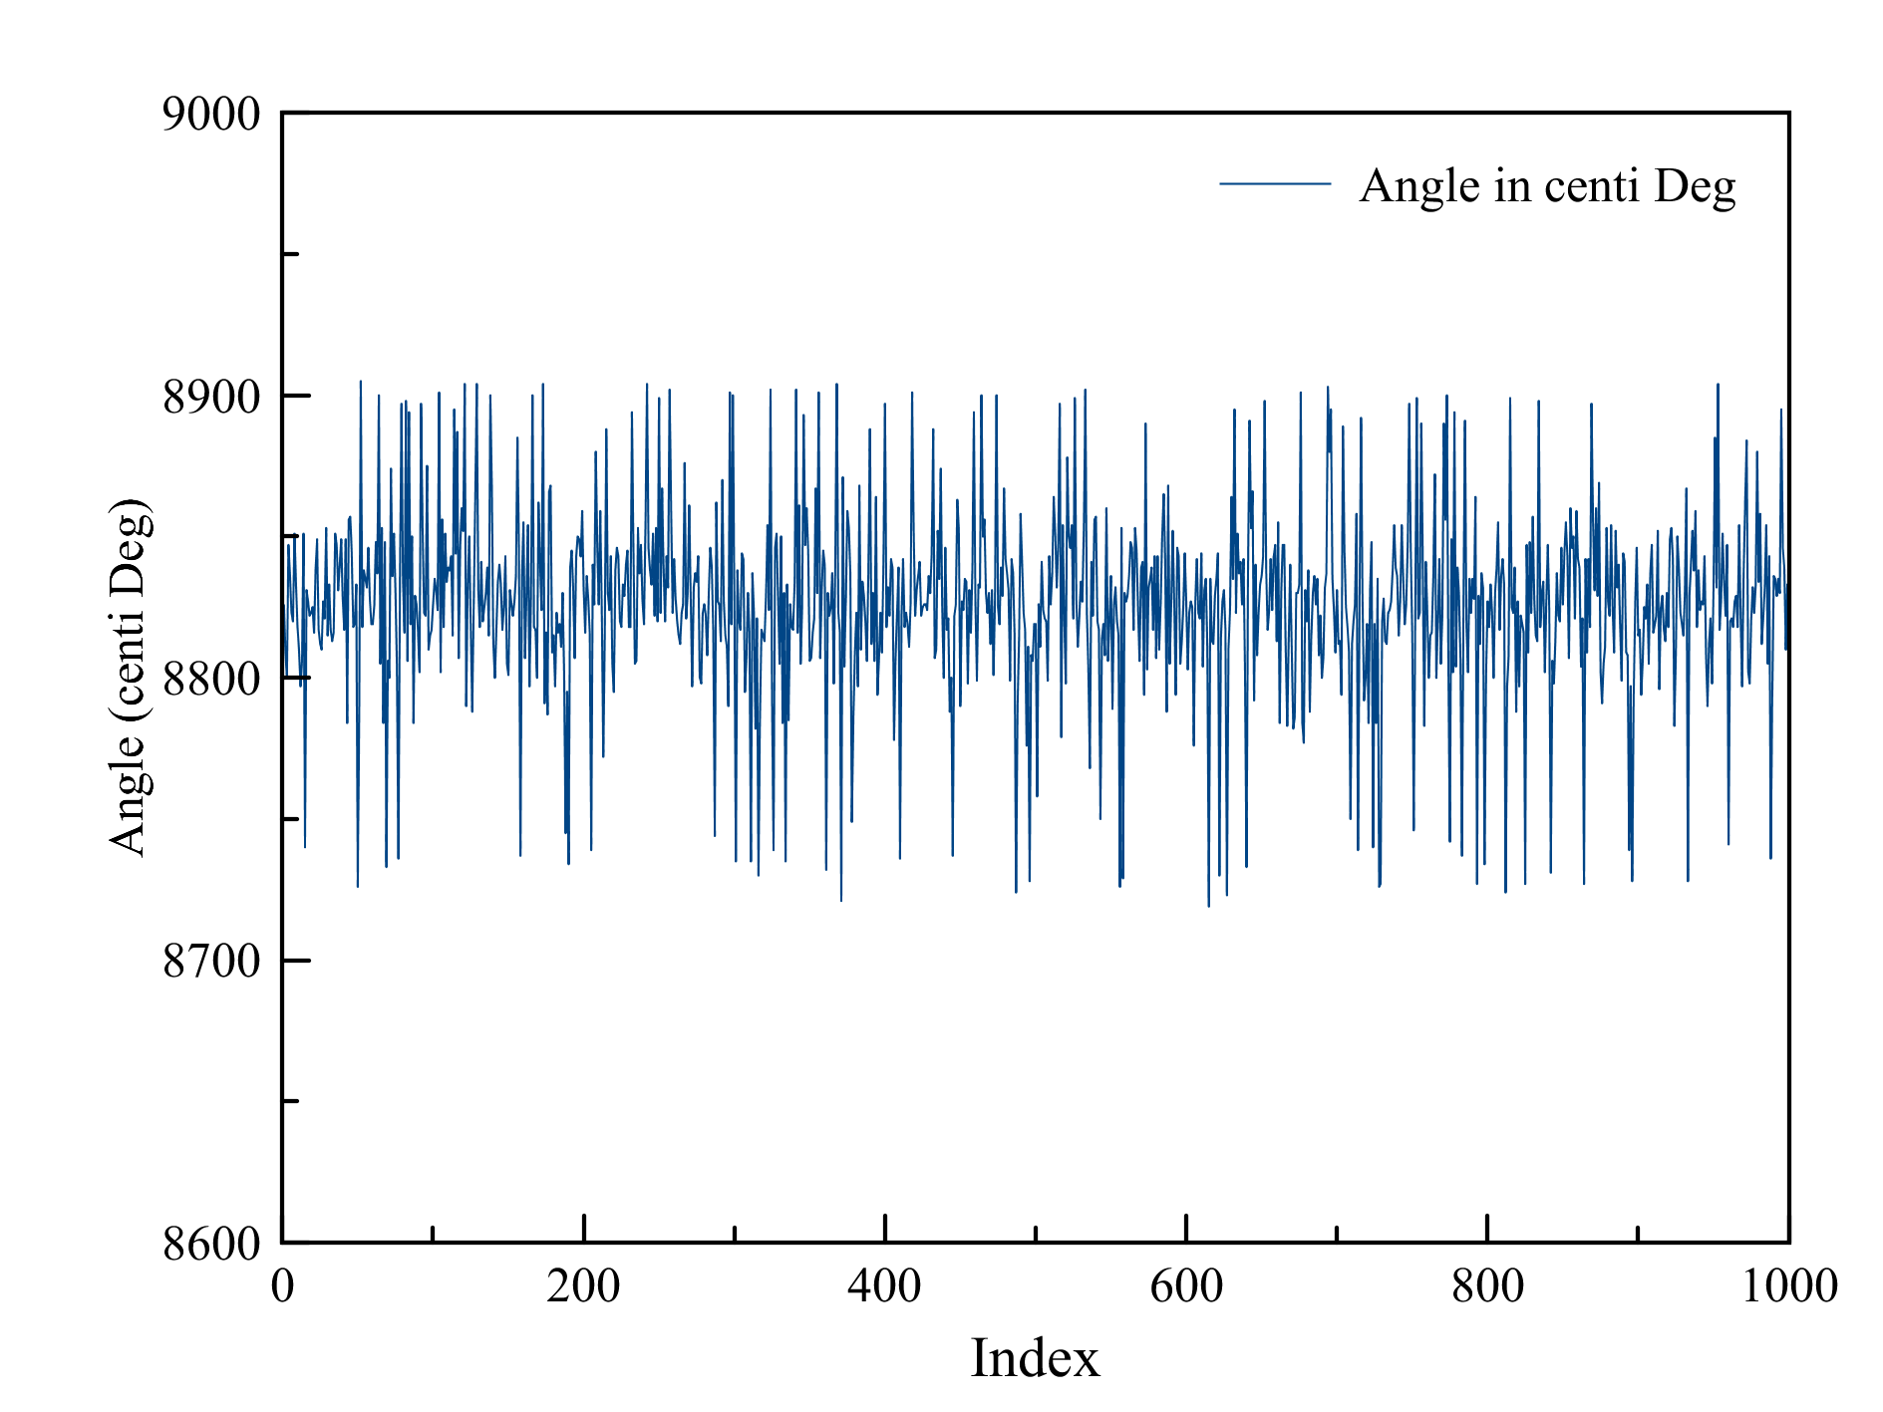
Bot angle calculation Accelerometer
Very noisy even in steady state

Slide 6
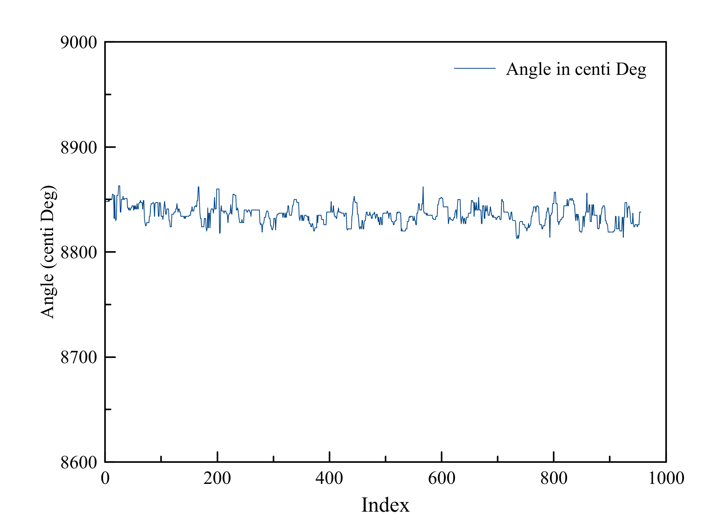
Bot angle calculation Accelerometer
Using simple median filter decreased much noise
Uses 10 last samples

Slide 7

Bot angle calculation Accelerometer
Using tan(α) instead of cos(α)
Two advantages
Excludes max value of accelerometer from consideration
Minimizes error by considering multiple axes
Angle does not drift, so good reference point
tan α =$\frac{z}{x}$
Z acc
X acc

Slide 8
Bot angle calculation Gyroscope
Integration over time
Very smooth, less noise
Calculated angle drifts over time
Since error in sensor data also get integrated
Non-zero offset of the sensor output
Sensor sensitivity is not constant

Slide 9
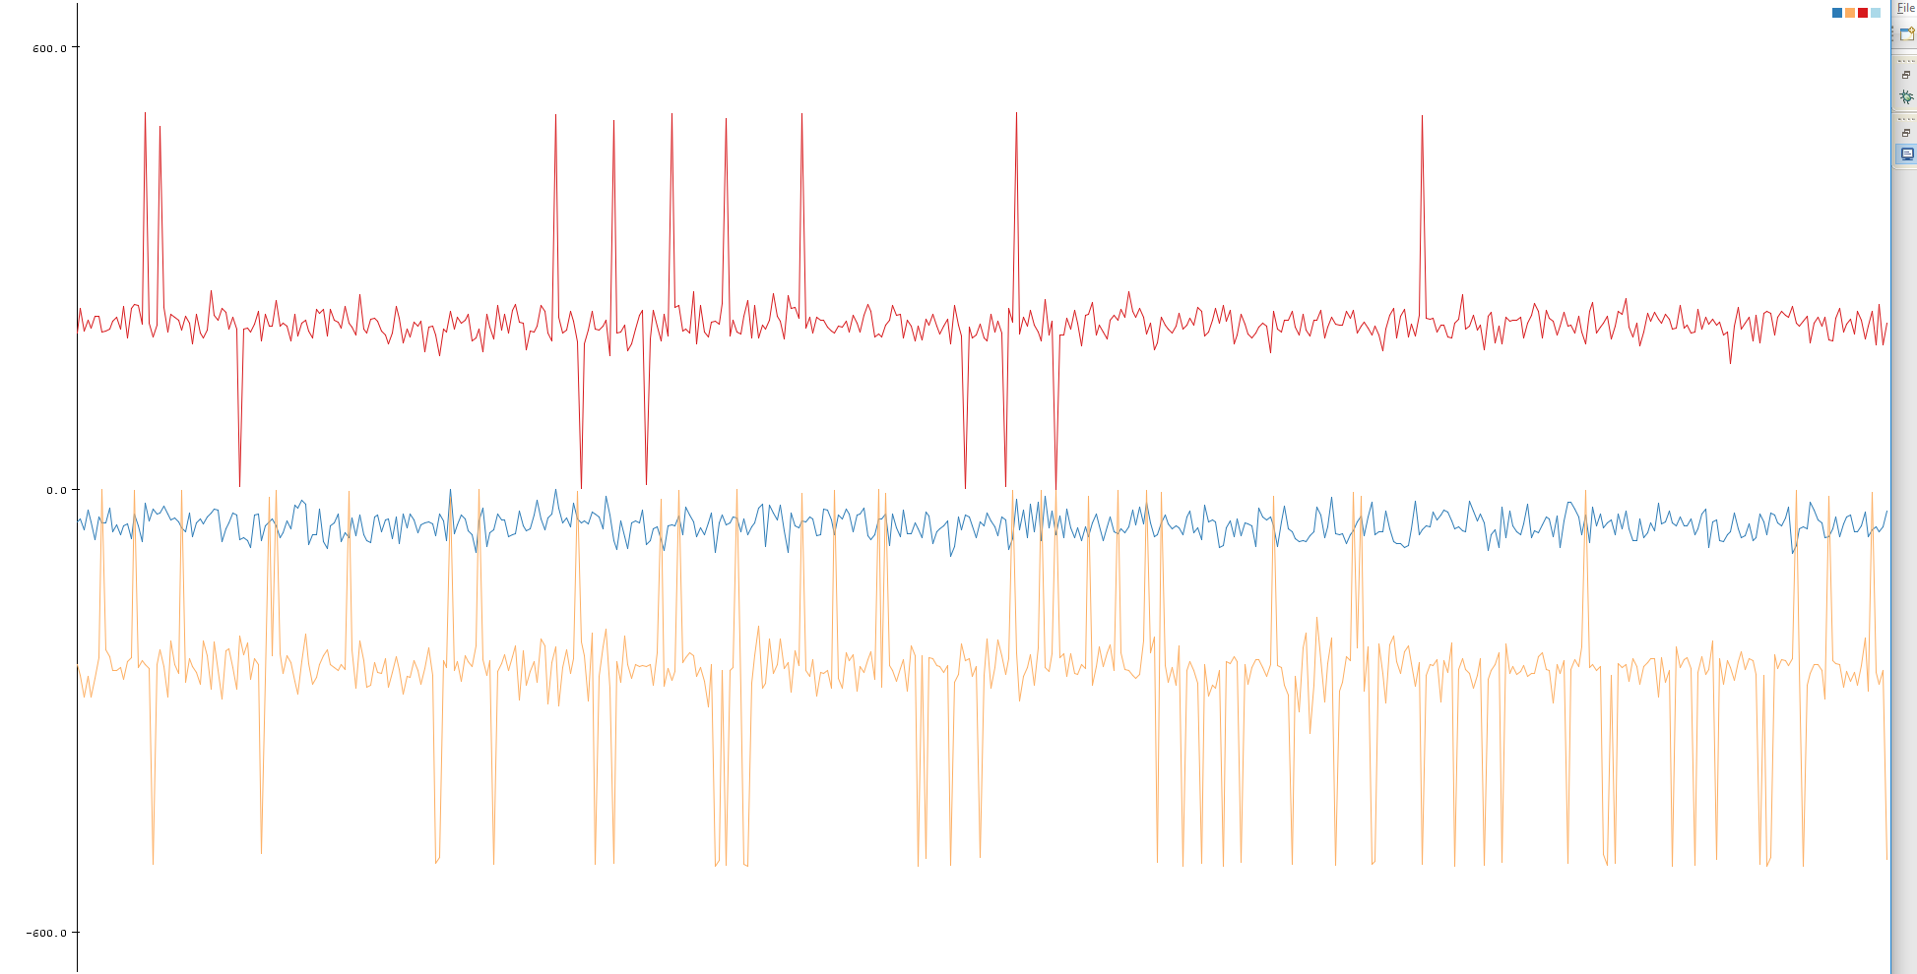
Bot angle calculation Gyroscope
X
Y
Z

Slide 10

Bot angle calculation Accelerometer + Gyroscope
What is the solution?
Complementary filter
$\text{(}a_{a}\text{− }a_{g}\text{)} \text{x} τ^{2}$ x ${dt}^{2}+\text{2}\text{(}a_{a}\text{− }a_{g}\text{)}$ x τ x ${dt}^{}+v{dt}^{}$

Slide 11
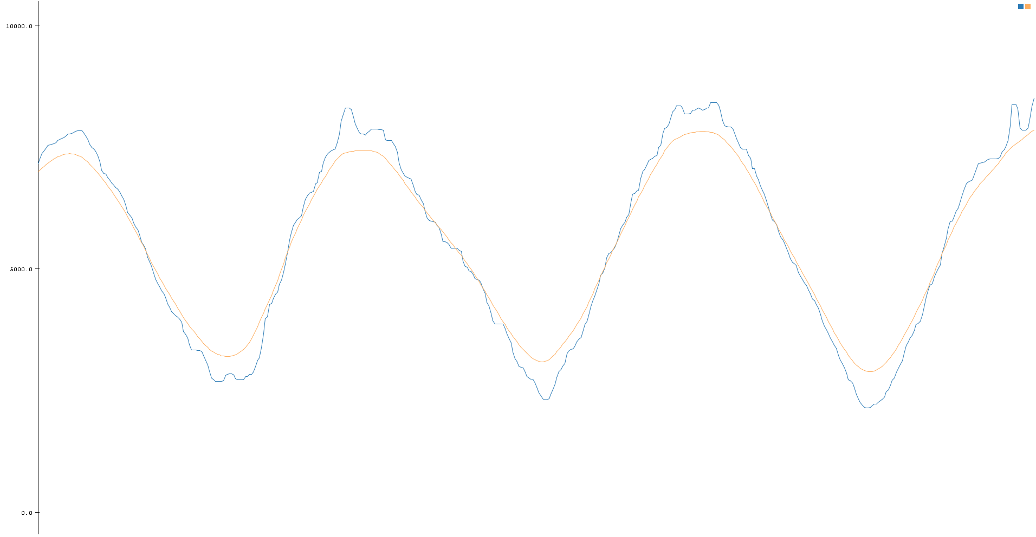
Bot angle calculation Accelerometer + Gyroscope
Acc angle
Filtered angle

Slide 12


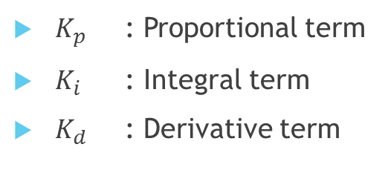

PID Controller
$$K_{p}$$
Set Point
-
Error
$$K_{i}$$
+
Actuator
$$K_{d}$$
Sensor Output
$K_{p}$ : Proportional term
$K_{i}$ : Integral term
$K_{d}$ : Derivative term

Slide 13



PID Controller
$$K_{p}$$
Angle offset
-
Error
$$K_{i}$$
+
Motor PWM
$$K_{d}$$
Measured angle
$K_{p}$ : Proportional term
$K_{i}$ : Integral term
$K_{d}$ : Derivative term

Slide 14
PID Controller
+
Angle PID
Angle Offset
Position PID
+
Angle PID
Angle Offset
Problem
Unstable bot even after PID tuning
Solution
Added offset to PWM values for each motor by measuring
Problem
Bot angle stabilizes, but not the position
Solution
Cascade position PID, add output of position PID to set point of angle PID
Another problem
Bot tries to stabilize position and angle both, but does not maintain the speed
Solution
Add another PID for speed control, add output of speed PID to set point of angle PID
Angle Offset
Position PID
Speed PID
+
Angle PID

Slide 15
Cascaded PID
Add position PID output to set point of angle PID
Position tries to stabilize but speed not
So, add speed PID output to set point of angle PID
One advantage is no need to add angle offset since position PID compensate for that
+
Position PID
Angle PID
Angle Offset
Speed PID

Slide 16
Future Enhancements
Directly use target speed PID to achieve desired motor speed
So, no need to add PWM offset to motors
Use onboard DMP to offload MPU value processing
Both encoder integration
Remote control
Height independent PIDs

Slide 17
Metrics
Single iteration runs in 14ms
Execution time should not be less than 10ms, it introduces velocity calculation errors

Slide 18

Hardware Modules
Tiva Launchpad
I2C module for MPU communication
Quadrature encoder module for motor encoder
Two modules
Acceptable input frequency is ${\frac{1}{4}}^{th}$ of the processor frequency
Direction change detection

Slide 19
Software Modules
PID controller library
Median filter
Complementary filter

Slide 20
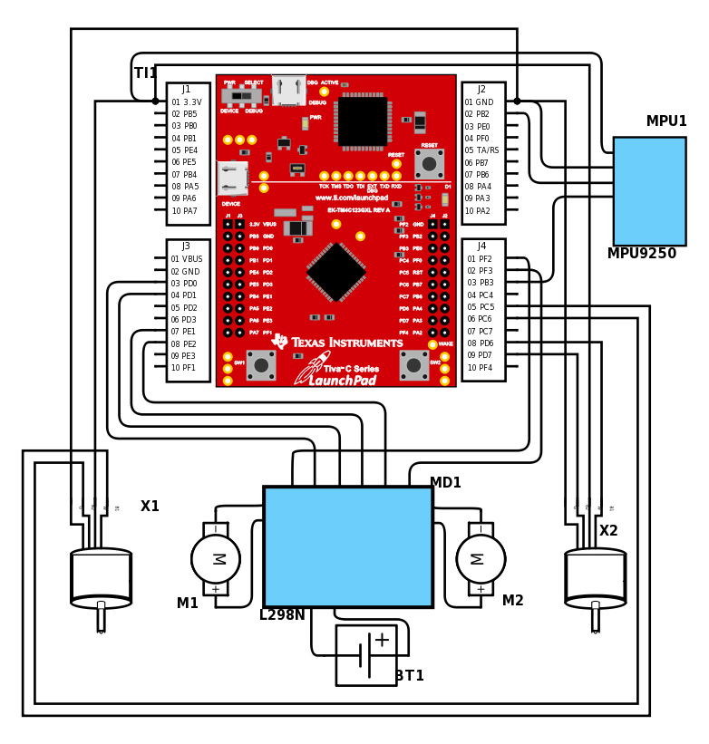
Connections Diagram

Slide 21
Project Timeline
Checkpoint | Date
MPU testing with Tiva Launchpad | 07 Oct 2016
Robot connection and basic motor movement | 09 Oct 2016
Angle measurement using accelerometer | 11 Oct 2016
Angle calculation using gyroscope | 11 Oct 2016
Sensor fusion using complementary filter | 12 Oct 2016
PID controller integration | 14 Oct 2016
Quadrature encoder module to track position | 16 Oct 2016
Position PID integration | 17 Oct 2016
Motor speed calculation and Speed PID integration | 19 Oct 2016
Another layer of speed PID to achieve desired speed | 23 Oct 2016

